Slide 1
Editörün Gözünden ‘Review Article’
https://researcheracademy.elsevier.com/writing-research/technical-writing-skills

Slide 2

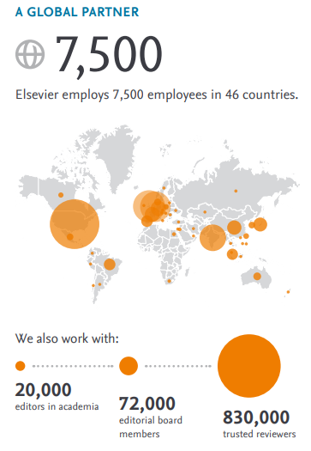








Elsevier
Over 200 years experiences
in scholarly publishing
+2.900
+3m
+630k
journals
peer-reviewd articles published in 2023
submissions in 2023
Elsevier
2 billion articles accessed in its journal platforms.
Other publishers
Source: https://www.elsevier.com/about
~ 3.7 m
Global Publication
Notes:
P

Slide 3
















Banu Bayram PhD. Senior Scientific Editor
ELSEVIER | NETHERLANDS
BSc, Biology
MSc & PhD, Medical Biology
Post-doctoral, Molecular Basis of Orthopedic Diseases
Previous editorial experience:
  Associate Editor – Gene ELSEVIER (2013-2022)
  Executive Editor – Human Gene ELSEVIER (2013-2016)
  Editor in Chief – Human Gene ELSEVIER (2016-2022)
b.bayram@elsevier.com

Slide 4






Elsevier’s Article Transfer Service (ATS)
Dergi Editörleri
Matching algorithms
Scientific Managing Editors
Transfer pre-review
Guaranteed peer-review
Editor, Destination Journal
Author
Transfer post-review
Transfer Recommended
Accept
Ethically sound manuscripts rejected from originating journal (pre-review or post- review)
Out of scope
Low priority
Preliminary data
Novelty
Scientific Managing Editors
Full-time in-house editors (or external editors)
PhDs in relevant subject areas
Provides transfer offer based on:
ATS data
Journal scope
Feedback from prior transfers
Editor insights
Reviewer
comments
Manuscript accepted
Improved manuscripts
‘Author Heroes’ can guide you on your publication journey (elsevier.com)

Slide 5
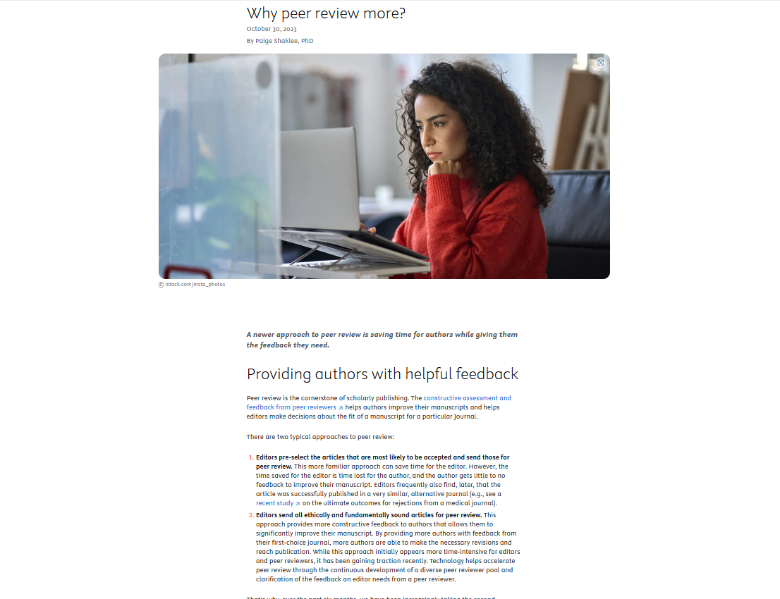

Slide 6

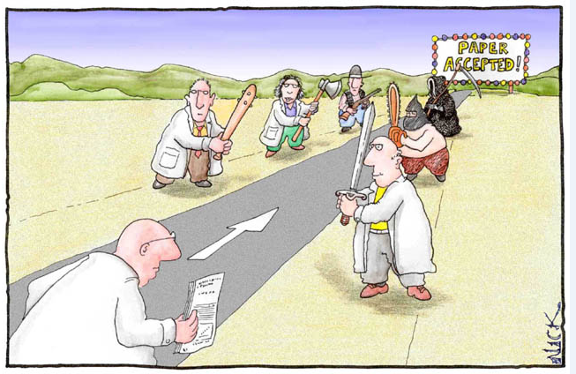




‘Review Article’
Editör
Hakemler
Yazar

Slide 7
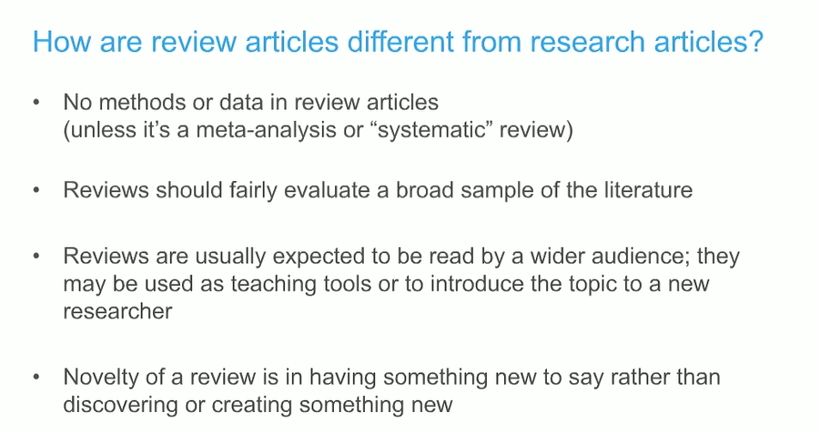
https://researcheracademy.elsevier.com/writing-research/technical-writing-skills

Slide 8

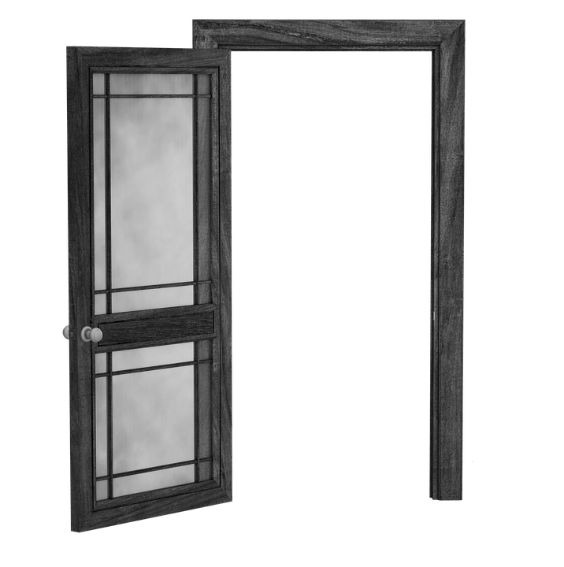


Why are reviews useful?
They organize, evaluate, and distill information
They are an entry point for students
They provide a bridge between fields
They direct and shape future research

Slide 9
Why write a review?
Not So Good Reasons
  You want to learn about a new subfield
  It seems like an easy way to get another line on your CV
Practical Reasons
  It’s an opportunity to demonstrate expertise in your subfield
  On average, reviews are cited and downloaded more than primary research articles
  It’s an opportunity to think deeply about the state of your subfield
Good Reasons
A Great Reason
  You can provide an insight that cannot be directly obtained from reading the primary empirical literature

Slide 10
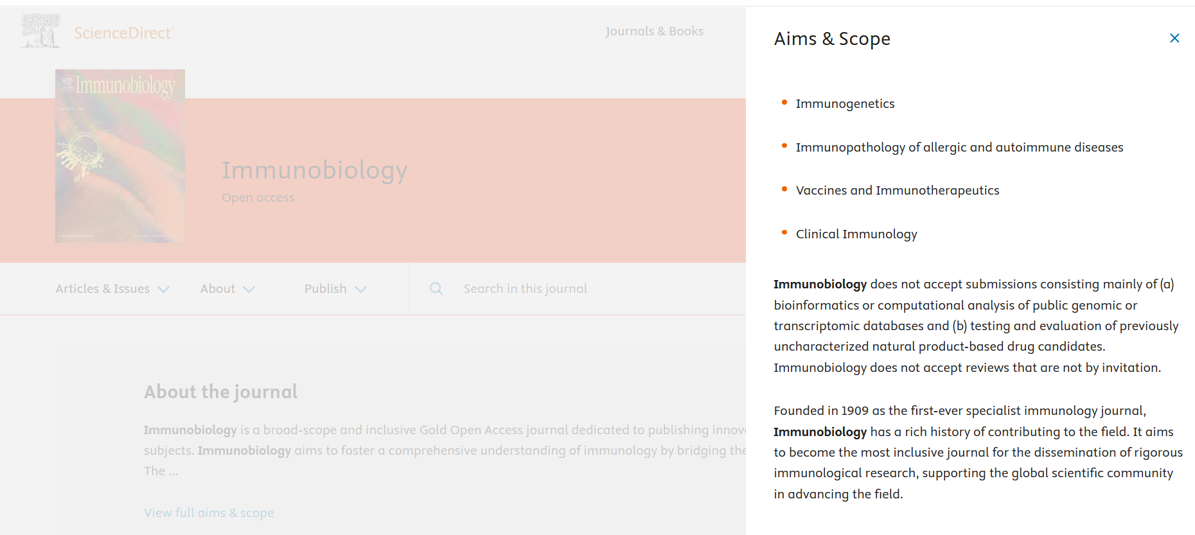
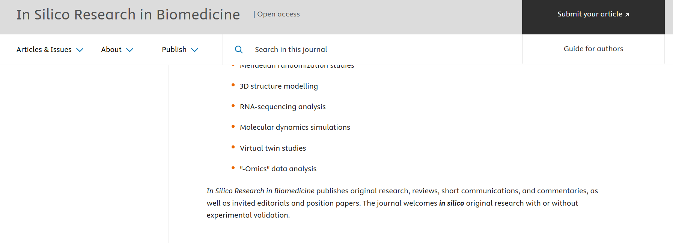
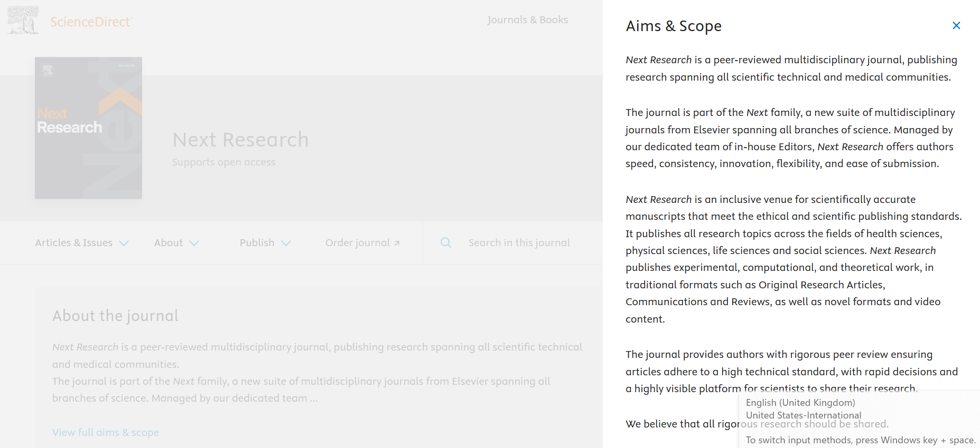


Doğru Dergi Seçimi
https://journalinsights.elsevier.com/
Makalenizi yazarken kullandığınız ana kaynakların nerede yayınlandığını kontrol edin.

Slide 11
What to include in a proposal
Davet
Include everything you just heard about, in a clear, succinct manner
Must haves
  Format (Review vs. Opinion vs. short article)
  Authors and affiliations
  Summary of the scientific content (extended abstract and/or outline)
  Why is it timely and why should we be interested?
  Are there other reviews on this topic, and if so, how is yours different?
  What is your personal expertise on the topic and what novel perspective can you include?
  What are some key references on the topic?
Feel free, but not compelled, to also include
  Figure drafts or legends
  Approximate word count
  Your own publication history in the field

Slide 12
What if the editor says no?
Doesn’t mean your proposal was bad
  Other reviews forthcoming
  Field isn’t ripe enough yet
  Out of scope
  Saving space for invitations (e.g., upcoming conference travel)
  Would benefit from additional author expertise
  Pipeline too full to add anything new

Slide 13
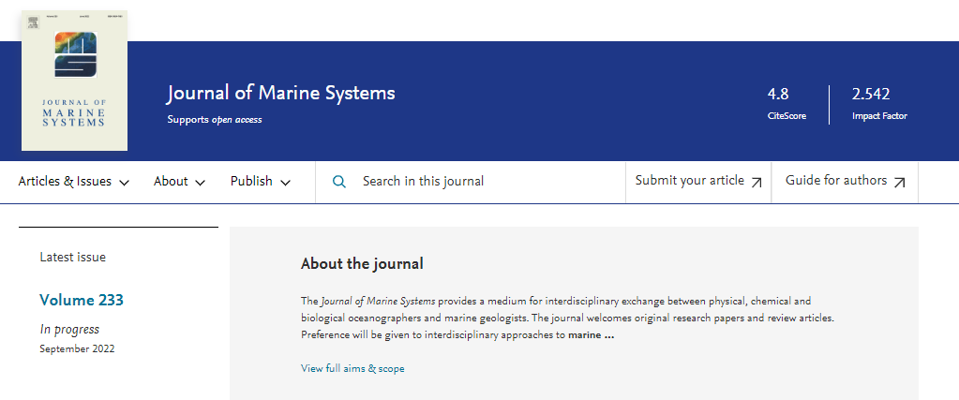

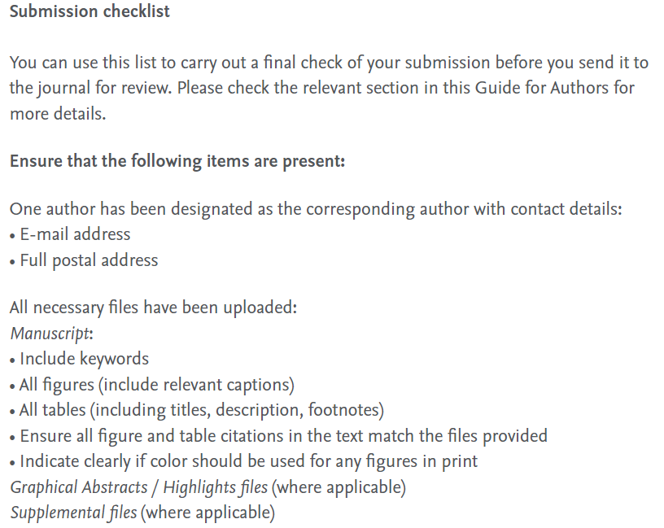
Seçtiğiniz dergiyi detaylı inceleyin
Guide for Authors
Aims & Scope
Notes:
Sadece 1 dergiye submission yapin

Slide 14
Basvuru ve Inceleme Süreci
Yazar
Editör
Hakem

Slide 15






These are the main reasons for desk rejection!
Editörler için ön değerlendirme kriterleri
Scope
Determine if the work aligns with the journal's scope.
English
Check if the language used in the article is appropriate and clear.
Significance or novelty
Assess whether the manuscript offers innovative or significant contributions.
Overall appeareance
Review whether the manuscript presentation meets required standards.
Ethics
Ensuring compliance with ethical standards in scientific publishing.
Authorship
Identity confidence check
Competing interest
Multiple submission
Duplicate Submission
Fabrication
Falsification
Plagiarism

Slide 16
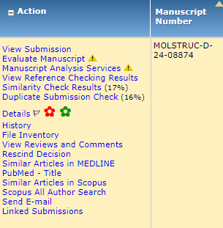
Editörlerin kullandığı ön değerlendirme sekmeleri

Slide 17
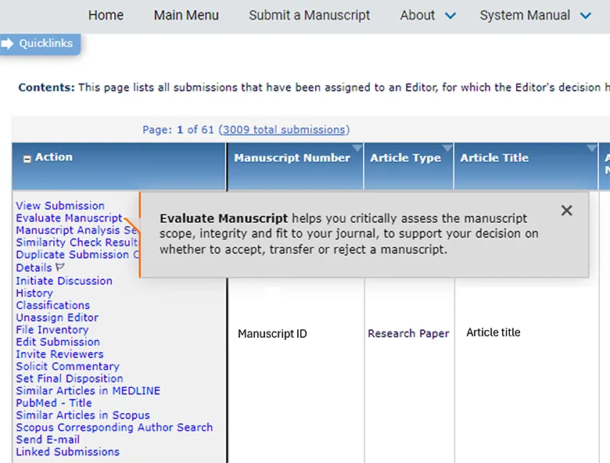
Evaluate Manuscript Tool
Notes:
This presentation is divided into three parts:
About Generative AI
AI in the publishing community
Elsevier and AI
At the end of the presentation, there will be time for questions. We can always go back to a certain slide or topic then, to discuss it in more depth.

Slide 18
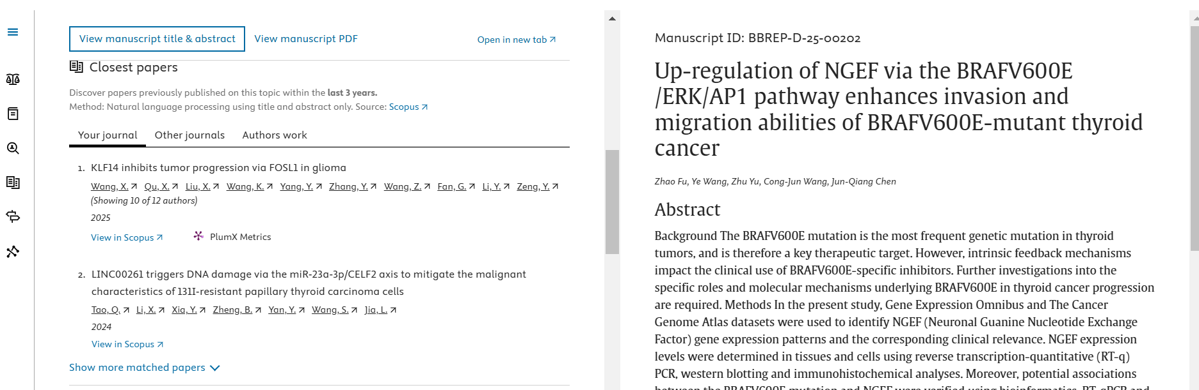
Evaluate Manuscript Tool
Significance or novelty

Slide 19
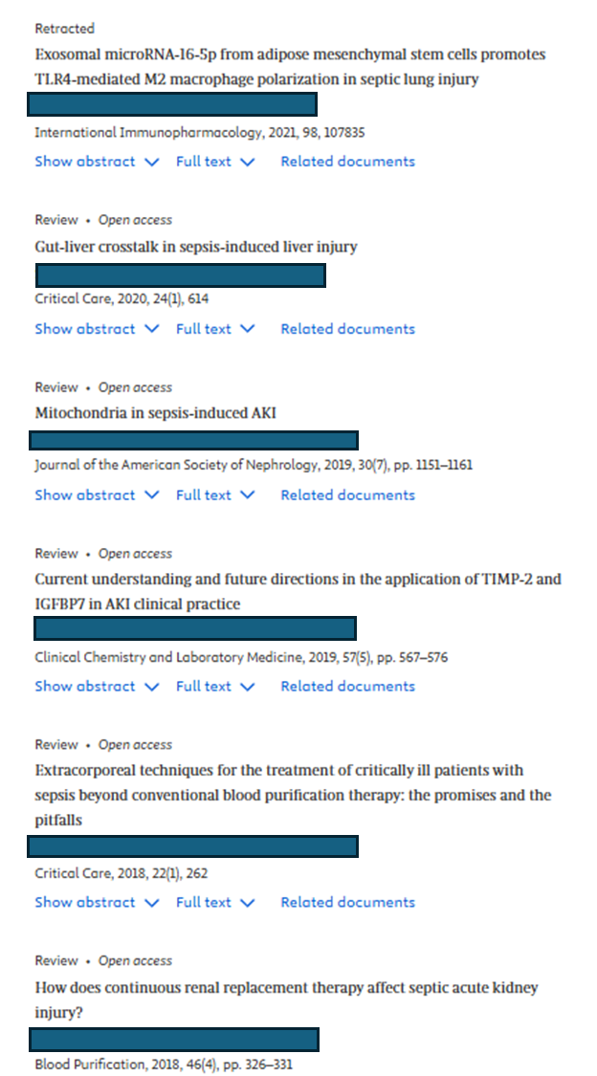
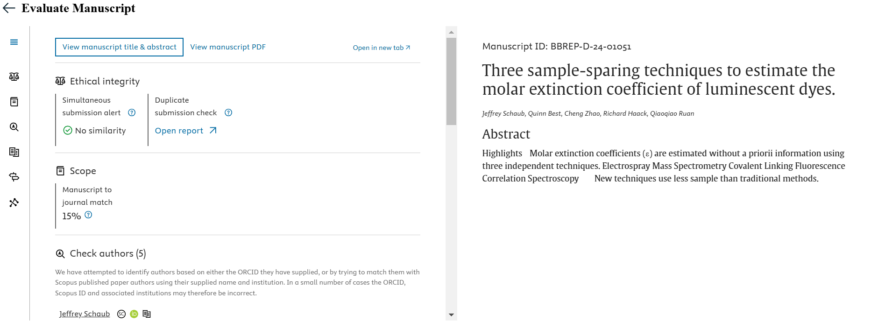
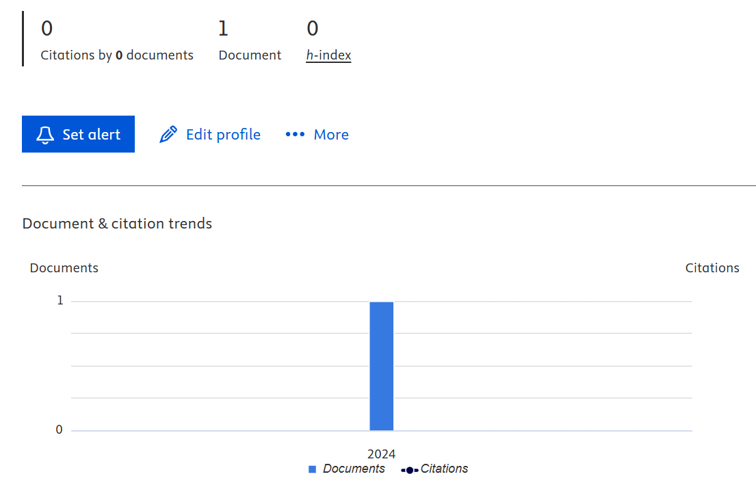
Evaluate Manuscript Tool
Ethics
Scope
Identity confidence check
Notes:
This presentation is divided into three parts:
About Generative AI
AI in the publishing community
Elsevier and AI
At the end of the presentation, there will be time for questions. We can always go back to a certain slide or topic then, to discuss it in more depth.

Slide 20
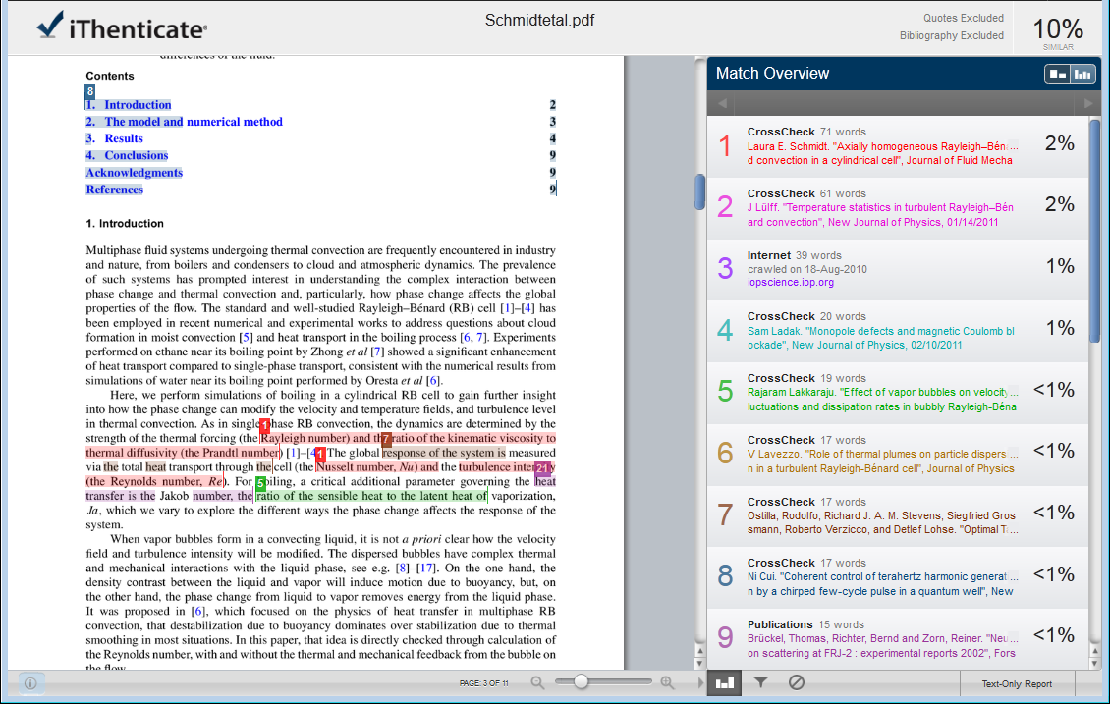
CrossCheck “Document Viewer”
All Sources
Match Overview
Generally, it is NOT count as prior publication:
Preprints (by the authors)
Thesis

Slide 21

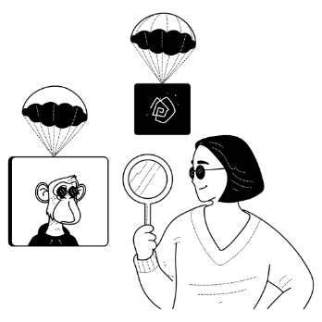


Generative AI Author policies
Authors
Editors and reviewers
Figures, images, artwork
Only use Generative AI to improve readability and language of work
Apply human oversight and control
Disclose use of Generative AI
Not list or cite Generative AI and AI-assisted technologies as (co) author
Not upload the manuscript into an AI tool- this may violate confidentiality and author’s rights
Not upload peer review report or editorial decision letters – they may contain confidential information as well
Generative AI should not be used to assist in the review, evaluation or decision-making process
Don’t use Generative AI to create or alter images in submitted manuscripts
Exception: Where the use of Generative AI or AI-assisted tools is part of the research design or research methods
The use of generative AI or AI-assisted tools in the production of artwork is not permitted (but may in exceptional cases be allowed for cover art)
Policies are published on Elsevier’s Publishing Ethics page: https://www.elsevier.com/about/policies/publishing-ethics. Further guidance can be found in the RELX Responsible AI Principles. https://www.elsevier.com/about/policies/responsible-ai-principles

Slide 22




Editör kararı
Rejected without review (desk reject)
Author submit
Desk reject
Tebrikler!!!
Editor review
Makalenin inceleme için hakemlere gönderilmesi
Reviewer review
Editor decide
Accept
Reject
Revise
Publish

Slide 23
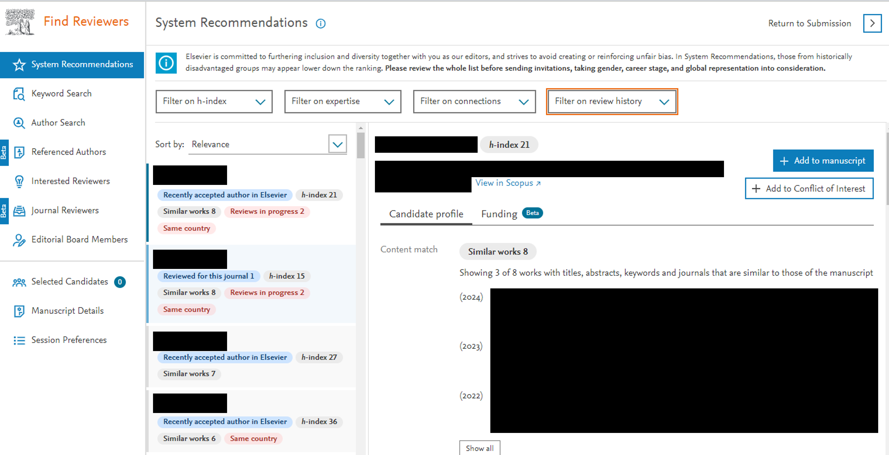
Finding Reviewers
Notes:
This presentation is divided into three parts:
About Generative AI
AI in the publishing community
Elsevier and AI
At the end of the presentation, there will be time for questions. We can always go back to a certain slide or topic then, to discuss it in more depth.

Slide 24
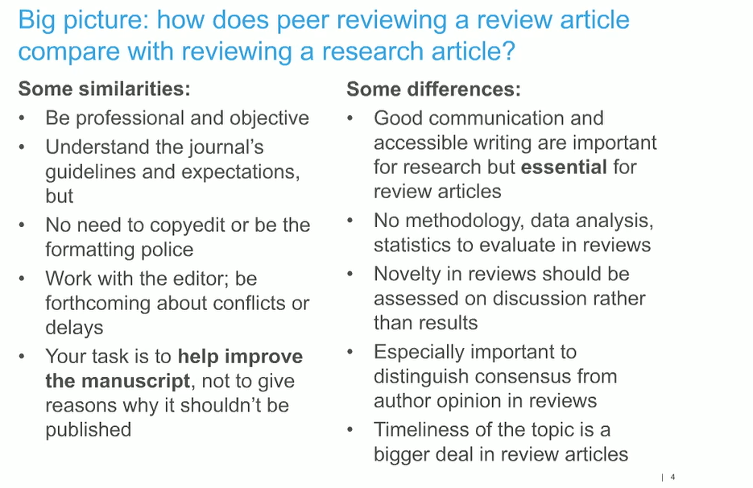

Slide 25
Top 10 Take-Aways
A review is not a list of results
Only write a review if you feel you have something to say
If possible, submit a proposal before writing the manuscript
In the proposal, make clear why the topic is important, why it is important now, and why you should write it
Know what journey you want to take your readers on
Manage readers’ expectations from the beginning
Avoid jargon
Expect to heavily revise the first draft
Follow the journal’s formatting guidelines
Remember, if you’ve been invited to submit a review, the editor wants you to succeed!

Slide 26
Teşekkür Ederim!
Banu Bayram, PhD
b.bayram@elsevier.com
https://researcheracademy.elsevier.com/writing-research/technical-writing-skills

